Slide 1
ONLINE Grocery SHOPPING DATABASE
Directed by: Prof Vidyacharan bhaskar
Presented BY:
SAHITI EMANI
STUDENT ID:19556

Slide 2
OVERVIEW:
INTRODUCTION
SCENARIOS
EER DIAGRAM OF ONLINE GROCERY STORE
ENTIES
ATTRIBUTES
RELATIONSHIPS
SUPERCLASS,SUBCLASS,INHERITANCE
PRIMARYKEY AND FOREIGN KEY
DISJOINT CONSTRAINTS
SQL COMMANDS IMPLEMENTED
CONCLUSION
REFERENCES

Slide 3
INTRODUCTION:
What is an ONLINE GROCERY SHOPPING WEBSITE?
Online grocery shopping is the activity or action of buying products or services over the Internet.
It means going online, landing on a seller’s website, selecting something, and arranging for its delivery.
The buyer either pays for the good or service online with a credit or debit card or upon delivery.
Online grocery shopping is part of E-Commerce, which stands for Electronic Commerce.

Slide 4
SCENarioS:
A customer can order to purchase/buy a product.
After ordering each customer will have a unique custid,(which is known as CUSTOMER ID),email,Fname,Lname,Phno and password. A customer can purchase one or more items in different quantities.
The items(Product) can be of different category(Milk,meat,veggies,snacks) and quantities based on their type.
There will be a relationship between (customer,order), (Order and Orderline)and (Orderline ,Product)table.
A customer can order many item. Each order will have a unique customer id, order id, lineid of orderline.

Slide 5
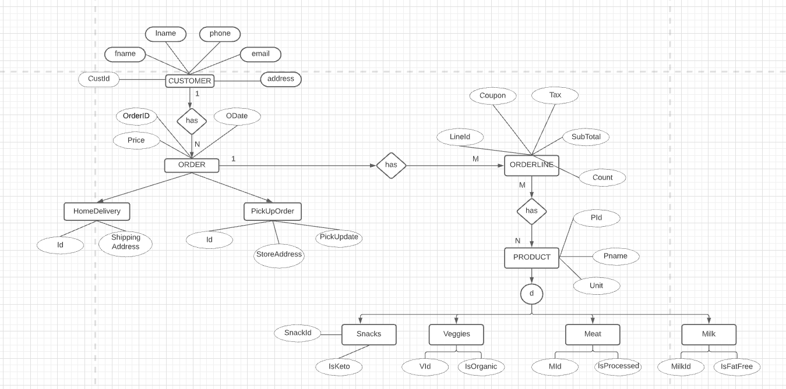
EER DIAGRAM OF an online grocery store ORDER SECTION:

Slide 6
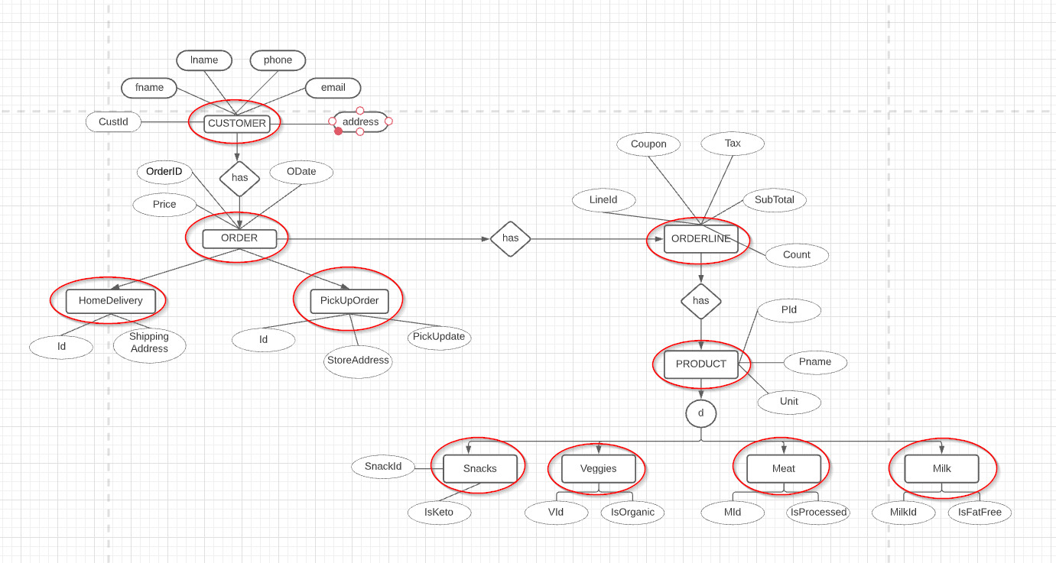
ENTITIES:Database entity is a thing, person, place, unit, object or any item about which the data should be captured and stored in the form of properties, workflow and tables. THEY are CUSTOMER,order,HOMEDELIVERY,PICKORDER,ORDERLINE,PRODUCT,SNACK,VEGGIES,MEAT,MILK.

Slide 7
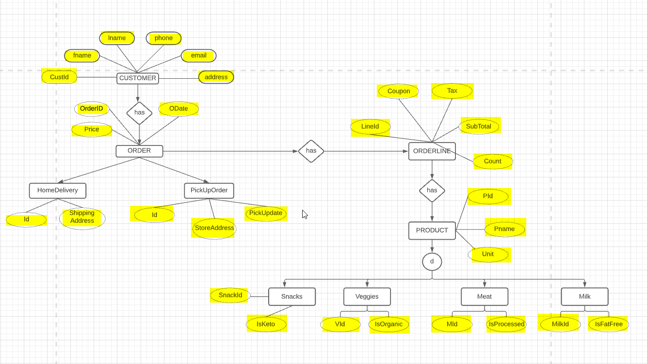
ATTRIBUTE: the characteristics or properties of an entity in a database table. They are :[CUSTID,FNAME,LNAME,ADDRESS,EMAIL,PNO-CUSTOMER],[ORDERID,ODATE,PRICE,-ORDER],[SHIPPINGADDRESS,ID-HOMEDELIVERY],[PICKUPDATE,STOREADDRESS,ID-PICKUPORDER],[LINEID,COUPON,TAX,SUBTOTAL,COUNT-ORDERLINE],[PID,PNAME,UNIT-PRODUCT],[SNACKID,KETo-SNACK],[VID,ORGANIC-VEGGIES],[MID,PROCESSED-MEAT],[MILKid,FATFREE-MIlk]

Slide 8
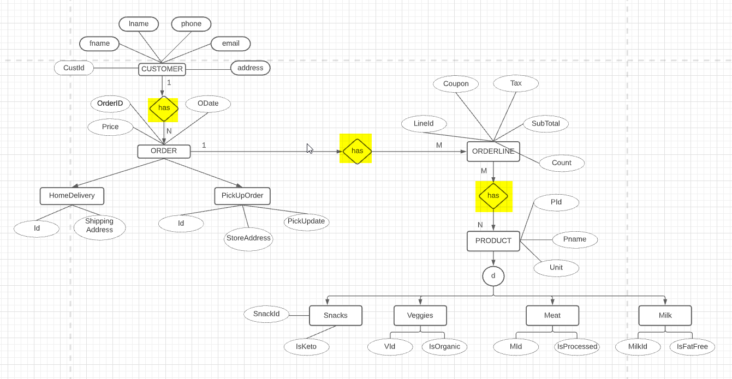
RELATIONSHIPS: a situation that exists between two relational database tables when one table has a foreign key that references the primary key of the other table. They are green diamond shaped structure. has.

Slide 9
Superclass,Subclass,inheritance
Superclasses
A superclass is the class from which many subclasses can be created.
The subclasses inherit the characteristics of a superclass. The superclass is also known as the parent class or base class.
Inheritance
The process of basing a class on another class i.e to build a class on a existing class. The new class contains all the features and functionalities of the old class in addition to its own.
For example:ORDER is superclass and HomeDelivery and PickUpOrder are he subclasses according the EER diagram.

Slide 10
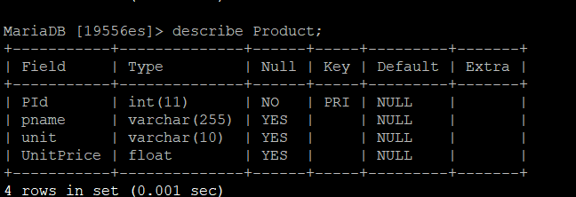
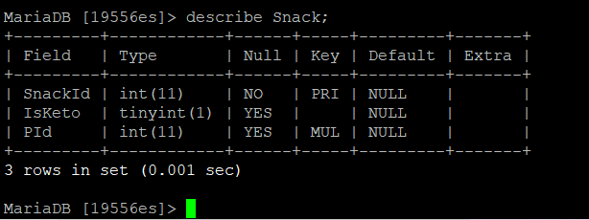
PRIMARY KEY:Primary keys must contain UNIQUE values, and cannot contain NULL values.
A table can have only ONE primary key; and in the table, this primary key can consist of single or multiple columns (fields).

Slide 11
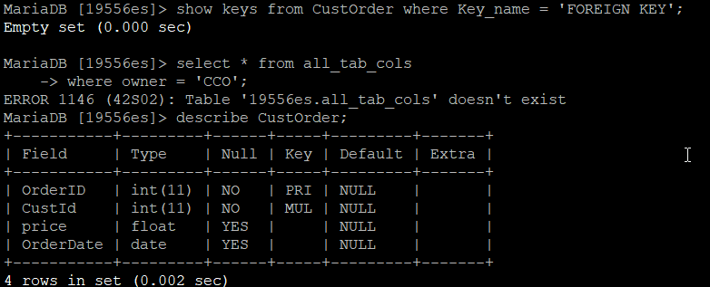
FOREIGN KEY:A FOREIGN KEY is a field (or collection of fields) in one table, that refers to the PRIMARY KEY in another table.
The table with the foreign key is called the child table, and the table with the primary key is called the referenced or parent table.

Slide 12
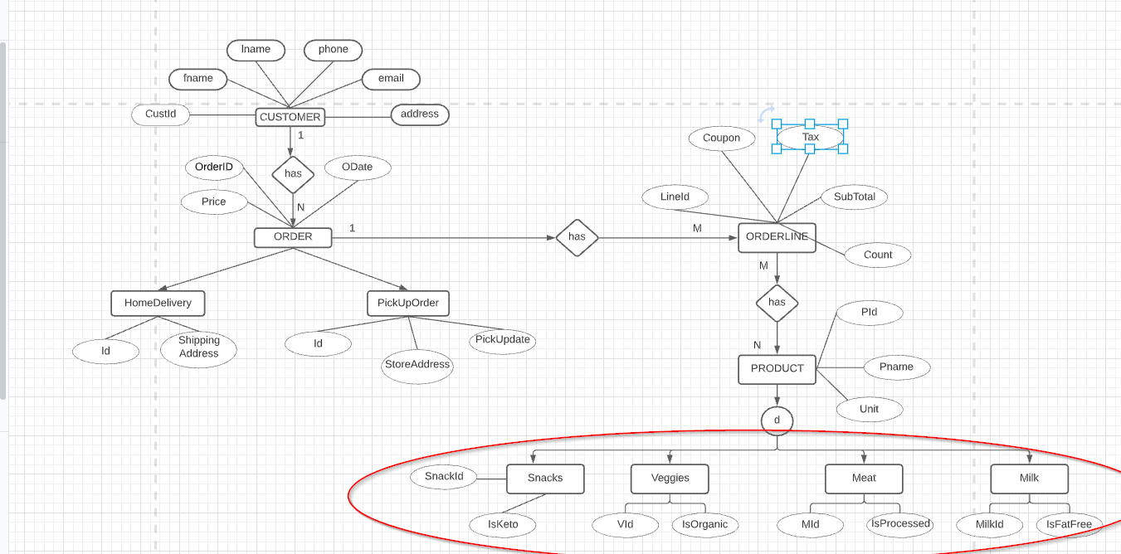
DISJOINT CONSTRAINTS:
Disjoint: The disjoint constraint only applies when a superclass has more than one subclass. If the subclasses are disjoint, then an entity occurrence can be a member of only one of the subclasses.
For example: Consider from the EER diagram mentioned above PRODUCT is an entity and it contains several other entities like MILK,MEAT,VEGGIES and SNACKS.
Using disjoint it means milk is not meat and meat not milk,which says they are not the same.

Slide 13
SQL COMMANDS : CREATED TABLES
//Get all customers with Orders (inner join)
select o.OrderId, c.CustID, c.fname, o.totalItems,o.price, o.OrderDate from Customer c join CustOrder o on c.CustID = o.CustId;
//get all customers with no orders
select c.CustID,c.fname from Customer c where c.CustID not in (select distinct(CustId) from CustOrder);
//select all customers, and any orders they might have
select c.CustID, c.fname, o.OrderId, o.OrderDate from Customer c left join CustOrder o on c.CustID = o.CustId;
//selects all customers, and all orders
select c.CustID, c.fname, o.OrderId, o.OrderDate from Customer c full join CustOrder o on c.CustID = o.CustId;
//select orderIds of all HomeDelivery and PickUp orders with total price > 90
select d.Id , O.OrderID as OrderId, O.CustId , O.price, O.totalItems from HomeDelivery d join CustOrder O on d.OrderId = O.OrderID and O.price>90 union
select p.Id , O.OrderID as OrderId, O.CustId , O.price, O.totalItems from PickUpOrder p join CustOrder O on p.OrderId = O.OrderID and O.price>90;
//Get the count of number of orders placed for each organic veggies (group by and Having Example)
select PId, count(OrderId) from OrderLine group by PId having PId in (select PId from Veggies);

Slide 14
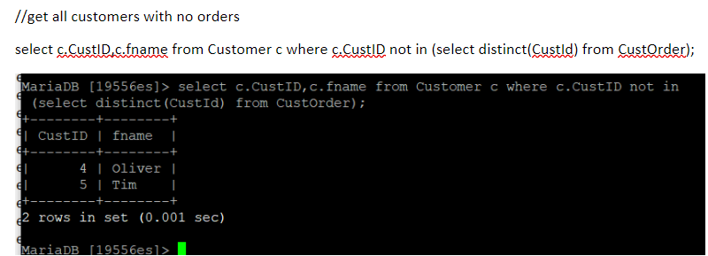
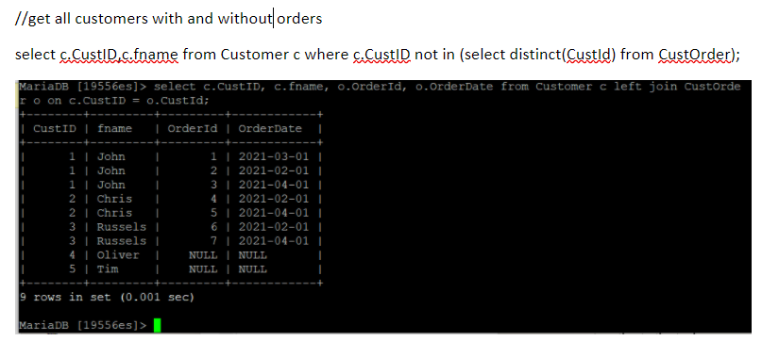
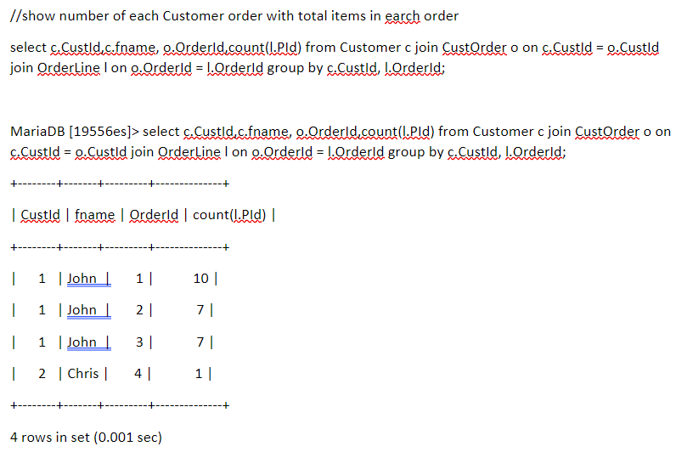
SQL QUERY Commands AND OUTPUTS:

Slide 15
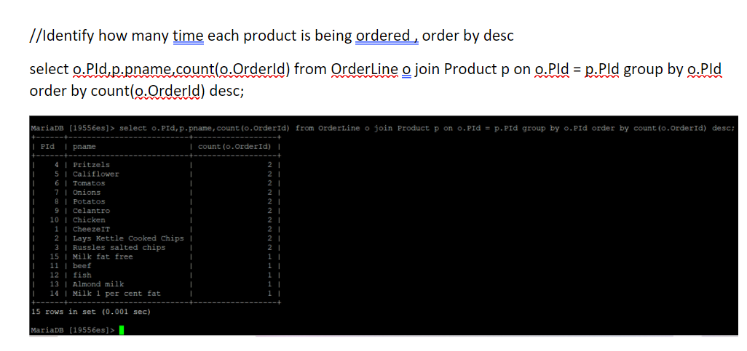

Slide 16
Conclusion:
Enhanced Entity-Relationship (EER) diagrams are an essential part of the modeling interface in MySQL Workbench.
EER diagrams provide a visual representation of the relationships among the tables in your model.
EER models are helpful tools for designing databases with high-level models. With their enhanced features, you can plan databases more thoroughly by delving into the properties and constraints with more precision

Slide 17
REFERENCES:
https://www.w3schools.com/sql/sql_foreignkey.asp
https://www.tutorialspoint.com/What-do-you-mean-by-PRIMARY-KEY-and-how-can-we-use-it-in-MySQL-table
https://meeraacademy.com/e-r-diagram-for-online-shopping-system/
https://dev.mysql.com/doc/workbench/en/wb-eer-diagrams-section.html

